Slide 2

Angular Forms

Slide 3
Agenda
What is Forms
Types of Forms
Difference between Reactive and Template Driven
Example on Reactive Form
Example on Template Driven Form

Slide 4
Angular – Forms
Angular forms are used to handle the user’s input. We use Angular form in our application to authorize users to log in, to update profile, to enter information, and to perform many other data-entry tasks.
In Angular, there are two approaches to handle the user’s input through forms:
Reactive Forms
Template-driven Forms
Both methods are used to collect user input event from the view, validate the user input, create a form model to update, and provide a way to track changes.
Reactive and template-driven forms process and manage form data differently. Each offers different advantages.

Slide 5
Angular – Reactive Forms
Reactive forms are more robust, and they are more scalable, reusable, and testable. If forms are a vital part of our application or are already using reactive patterns for building our app, handle responsive forms.

Slide 6
Angular – Template Driven Form
It is useful for adding a simple form to an app, such as an email list signup form to an app, such as an email list signup form. It is easy to add to an app, but they don’t scale as well as reactive forms. If we have fundamental form requirements and logic that can be managed in the template and use template-driven forms.

Slide 7
Angular – Forms
Difference between Reactive and Template driven forms
Template-driven Forms | Reactive Forms
Template-driven forms make use of the "FormsModule“. | Reactive forms are based on "ReactiveFormsModule“.
Template-driven forms are asynchronous (as it delegate task of creation of control). Template-driven forms delegate creation of their form controls to directives. i.e. [NgModel] or [NgForm] (directives) | Reactive forms are synchronous (as you create controls from you code). In reactive forms, you create the entire form control tree in code.
In a template-driven approach, most of the logic is driven from the template. | In reactive-driven approach, the logic resides mainly in the component or typescript code.
Suitable for simple scenarios and fails for complex scenarios. | Handles any complex scenarios.
Unit testing is another challenge. | Easier unit testing.

Slide 8
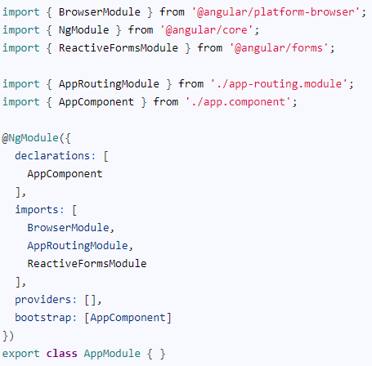
Angular – Reactive Forms Example Application
Use ng new to create a new application
Import ReactiveFormsModule
To work with Reactive forms, we must import the ReactiveFormsModule. We usually import it in root module or in a shared module. The ReactiveFormsModule contains all the form directives and constructs for working with angular reactive forms.

Slide 9
Angular – Reactive Forms Example Application
Model
We need to import FormGroup, FormControl & Validator from the @angular/forms. Open the app.component.ts and the add following import statement.
Form Group
The FormGroup takes 3 arguments. a collection of a child FormControl, a validator, and an asynchronous validator. The validators are optional.

Slide 10
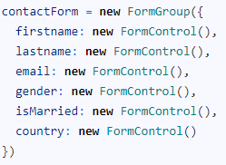
Angular – Reactive Forms Example Application
The first argument to FormGroup is the collection of FormControl. They are added using the FormControl method as shown below
In the above, we have created an instance of a FormGroup and named it as contactForm. contactForm is our top-level FormGroup. Under the contactForm, we have five FormControl instances each representing the properties firstname. lastname.email, gender, ismarried & country.
The Other two arguments to FormGroup are Sync Validator & Async Validator. They are optional.

Slide 11
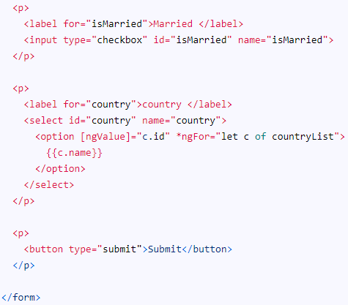
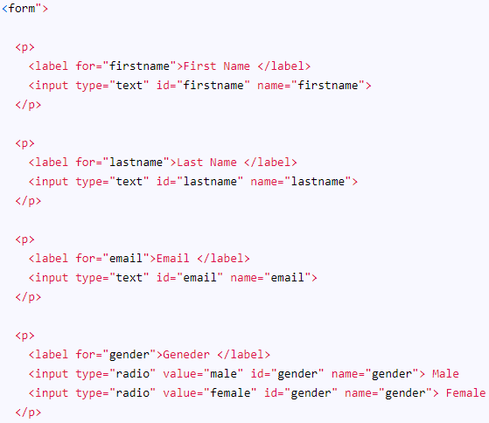
Angular – Reactive Forms Example Application
HTML Form
The following is a regular HTML form. We enclose it in a <form> tag. We have included two text input (FirstName & LastName), an email field, a radio button (gender), a checkbox (isMarried), and a select list (country).

Slide 12

Angular – Reactive Forms Example Application
Binding the template to the model
Now we need to associate our model to the Template using the formGroup directive as shown below.
We need to bind form fields to the FormControl models. We use the FormControlName directive for this. We add this directive to every form field element in our form. The value is set to the name of the corresponding FormControl instance in the component class.

Slide 13
Angular – Reactive Forms Example Application
We submit the form data to the component using the Angular directive named ngSubmit. Note that we already have a submit button in our form. The ngSubmit directive binds itself to the click event of the submit button. We are using event binding (parentheses) to bind ngSubmit to OnSubmit method. When the user clicks on the submit button ngSubmit invokes the OnSubmit method on the Component class

Slide 14
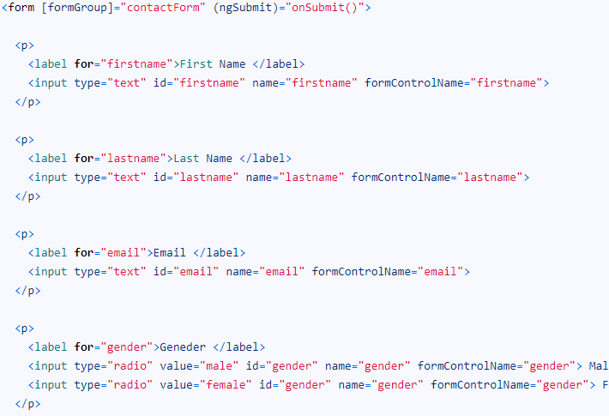
Angular – Reactive Forms Example Application
Final Template

Slide 15
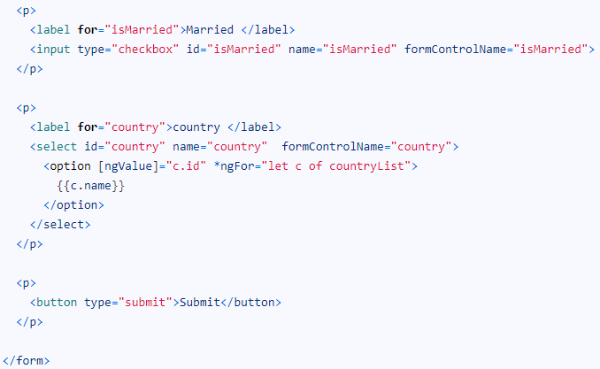
Angular – Reactive Forms Example Application

Slide 16

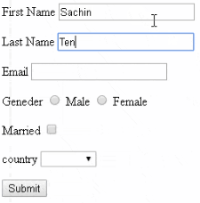
Angular – Reactive Forms Example Application
Receive the data in the Component class
The last step is to receive the form data in the component class. All we need to do is to create the onSubmit method in our component class.
We are using the console.log(this.contactForm.value) to send the value of our form data to the console window.

Slide 17

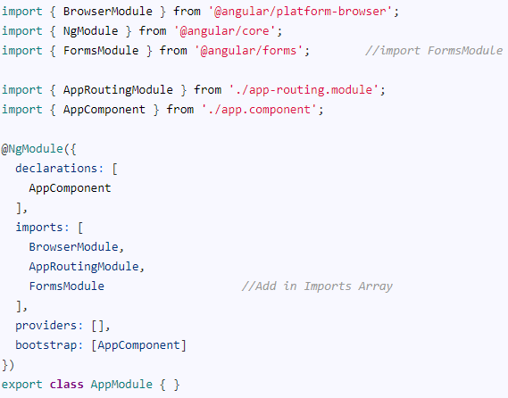
Angular - Template Driven Form Example Application
Use ng new to create a new application
Import FormsModule
The FormsModule contains all the form directives and constructs for working with forms
Open the app.module.ts and add the import { FormsModule } from '@angular/forms'; to it.
And also add the FormsModule to the imports metadata property array

Slide 18
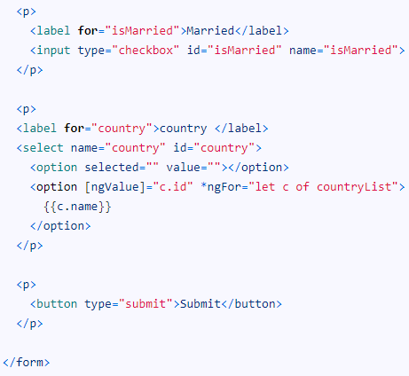
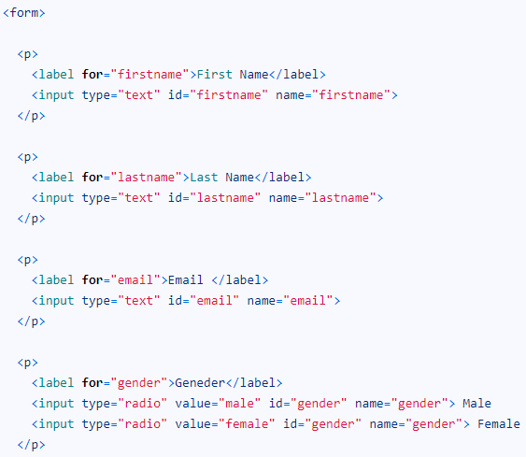
Angular - Template Driven Form Example Application
HTML Form
The following is a regular HTML form. We enclose it in a <form> tag. We have included two text input (FirstName & LastName), a email (email), a radio button (gender), a checkbox (isMarried), and a select list (country).

Slide 19
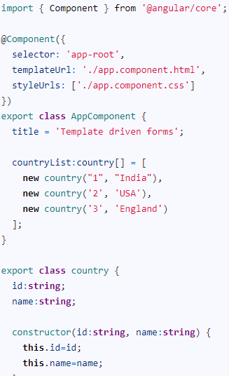
Angular - Template Driven Form Example Application
Component Class

Slide 20

Angular - Template Driven Form Example Application
ngForm
Once, we have a form with few form elements, the angular automatically converts it into a Template-driven form. This is done by the ngForm directive.
The ngForm does the following
Binds itself to the <Form> directive
Creates a top-level FormGroup instance
CreatesFormControl instance for each of child control, which has ngModel directive.
CreatesFormGroup instance for each of the NgModelGroup directive.
We can export the ngForm instance into a local template variable using ngForm as the key (ex: #contactForm="ngForm"). This allows us to access the many properties and methods of ngForm using the template variable contactForm

Slide 21
Angular - Template Driven Form Example Application
FormControl
The FormControl is the basic building block of the Angular Forms. It represents a single input field in an Angular form.
The Angular Forms Module binds the input element to a FormControl. We use the FormControl instance to track the value, user interaction and validation status of an individual form element. Each individual Form element is a FormControl.
We have six form elements in our HTML template. They are firstName, lastname, email, gender, isMarried & country. We need to bind them to FormControl instance. We do this by using the ngModel directive. Add the ngModel directive to each control as shown below.

Slide 22
Angular - Template Driven Form Example Application
Submit Form
We use the ngSubmit event, to submit the form data to the component class. We use the event binding (parentheses) to bind ngSubmit to OnSubmit method in the component class. When the user clicks on the submit button, the ngSubmit event will fire.
We are passing the local template variable contactForm in onSubmit method. contactForm holds the reference to the ngForm directive. We can use this in our component class to extract the data from the form fields.

Slide 23
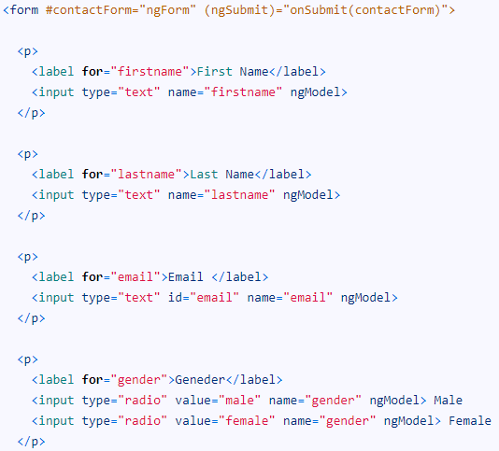
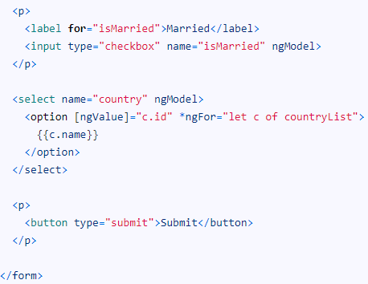
Angular - Template Driven Form Example Application
Final Template

Slide 24

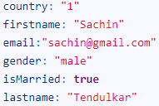
Angular - Template Driven Form Example Application
Receive Form Data
We need to receive the data in component class from our form. To do this we need to create the onSubmit method in our component class. The submit method receives the reference to the ngForm directive, which we named is as contactForm. The contactForm exposes the value method which returns the form fields as a Json object.
Run the code now and enter some data into the form. Open the Developer Console in browser and check the output, when you submit the data.

Slide 25
THANK YOU

